Slide 1
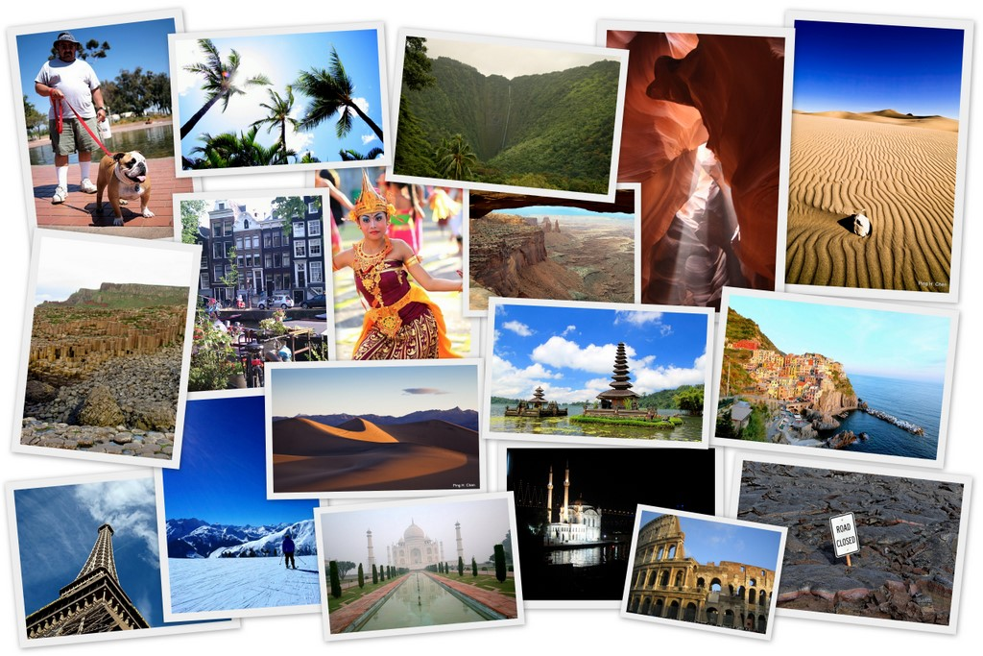
Travel Explorers
AC32005 – Group 1

Slide 2

The Presentation will consist of :
What is Travel Explorers?
Scenario of use
Research Methods
Online Research
Focus Group Findings
Future Plans
Questions

Slide 3
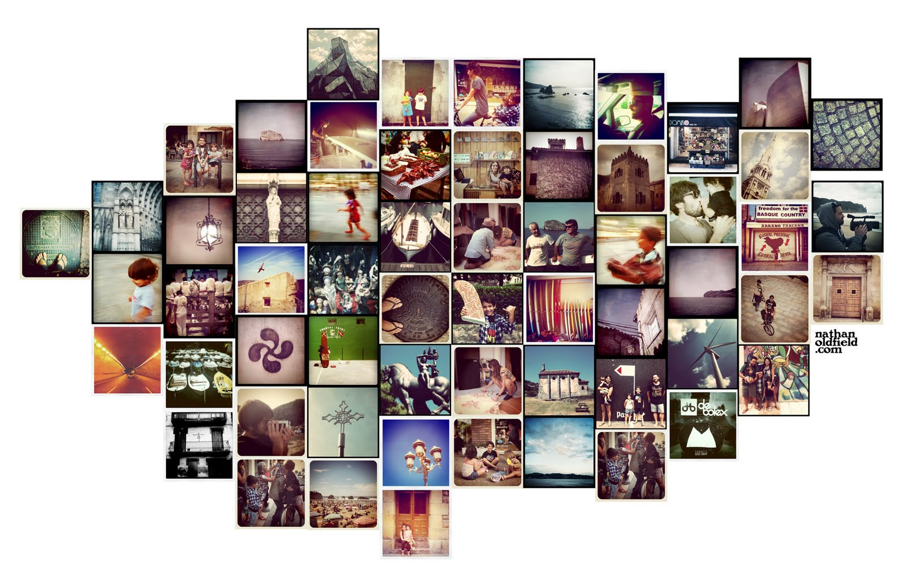
What is Travel Explorers?
Intergenerational communication

Slide 4
Travel Explorers is
Travel Explorers is a website that fills in a unique gap in the market between services that offer information on planning trips and services that allow you to book travel and accommodation associated with a trip.
Solves this by allowing and promoting users to meet like minded individuals to organize a trip and participate in something new.
It is designed to be simplistic allowing anyone to use it regardless of age or restrictions an individual may have whilst accessing a system.
It will allow Intergenerational communication by parsing data into a template format that is easy to read, understand, and making it accessible to all.

Slide 5
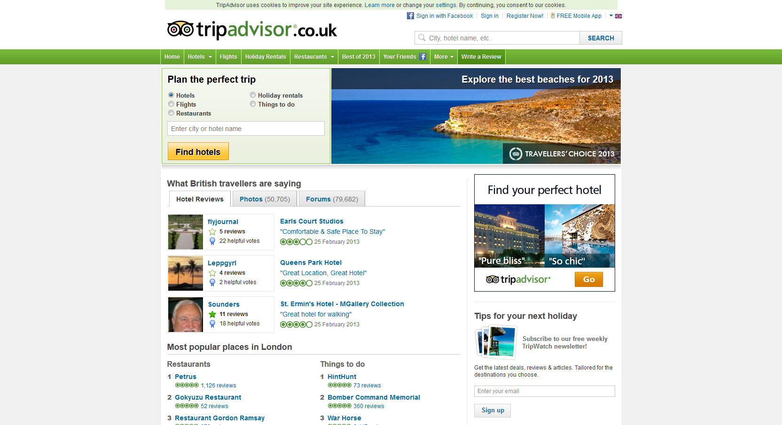
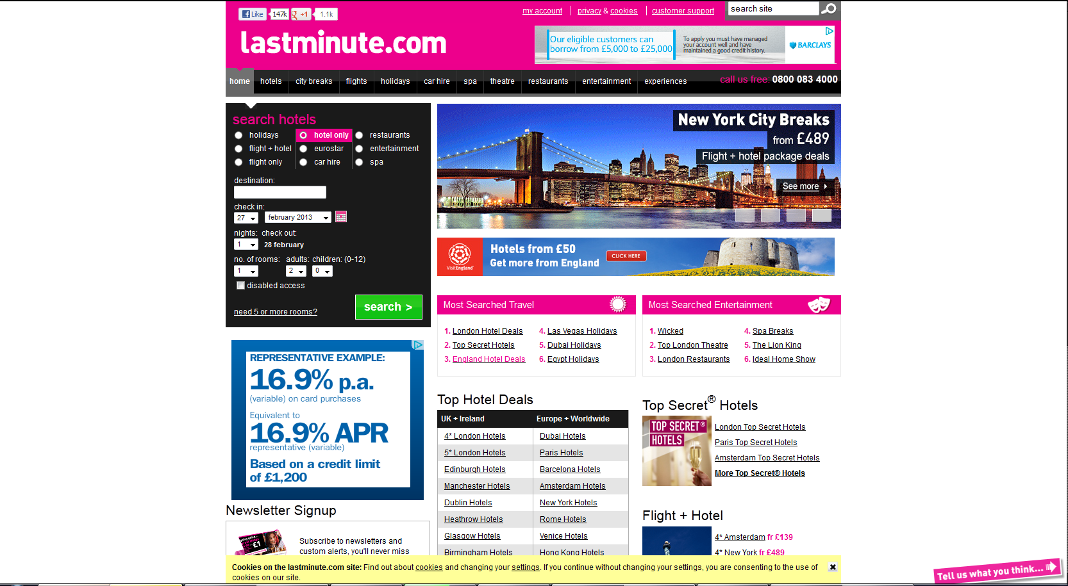

Similar systems
Planning / Gathering Information for a Trip
Something is Missing
Booking the necessary travel and accommodation requirements for a Trip

Slide 6

The Missing Link
The Social aspect of meeting like minded individuals that want to participate in the same activity or trip is not always possible in current social circles.
Communication with other individuals with a shared interest is what brings it all together. An interest such as cathedrals is commonly and there is often local trips to cathedrals all over Scotland.
Access to information in an easy to obtain way and to resources that allow users to take part and meet new individuals solves this problem regardless of age.

Slide 7
Scenario
A brief glimpse as how this system could be used.

Slide 8
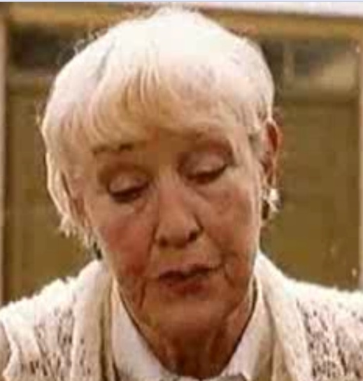
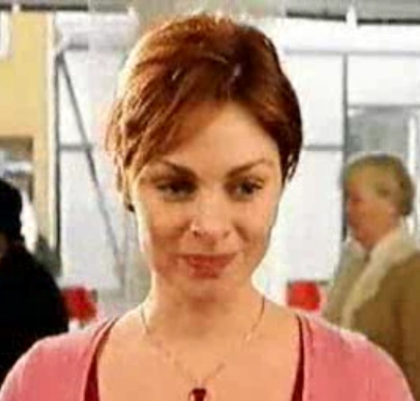
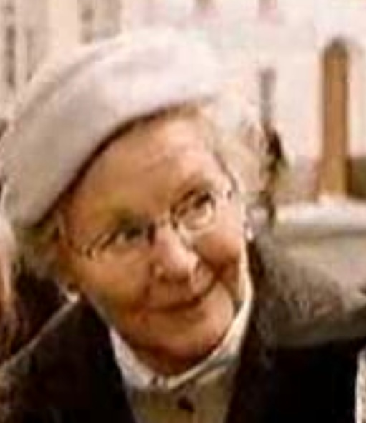
Scenario
Setting the Scene
A group of elderly woman travel from the UK to provincial France to visit an amazing little Patisserie shop. They are discussing things they have done in the past and wish they had done more of before getting old.
Each wants to share something different but they share a common goal even if they have different reasons. There is where media comes in. Photos, Video, and other types of media allows each to share their memories.
Angela wants to find and taste the best local food in the area
Andria facilitates the needs of both by giving everyone a place to share.
Betty wants to take and share photographs and videos of places she fondly remembers

Slide 9
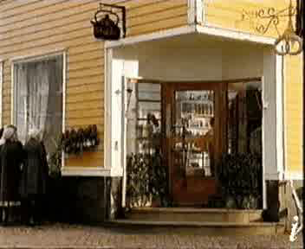
The Scenario
Patisserie Baker :
“ You are never too old!”.

Slide 10
Research methods

Slide 11

Research Methods Used
Online Research
Comparison of Similar Systems
Surveys and Focus Groups
Paper Prototyping

Slide 12
Online Research

Slide 13
Online Research
This study surveyed American adults 50+ to better understand their use of social media and technology. The survey was
conducted May 12 – May 17, 2010 by GfK among a nationally representative sample of 1360 adults age 50 or older.
General Internet Use
Two out of five (40%) adults age 50 and over consider themselves extremely (17%) or very (23%) comfortable using the Internet.
Access to Internet enabled device
The majority of those 50+ who access the Internet do so from a desktop computer (57%).
One-quarter use a laptop (26%), 4 percent use smartphones/blackberries, 4 percent use mobile phones, and one-quarter (27%) do not access the Internet.
aarp. (2010). Social Media and Technology Us e Among Adults 50+ (AARP 2010) Social Media and Technology Use Among Adults 50+. Available: http://assets.aarp.org/rgcenter/general/socmedia.pdf. Last accessed 27th Febuary 2013.

Slide 14
Online Research
Social Media Usage
Approximately one-quarter of all those 50+ use social media websites (27%) with Facebook being by far the most popular (23%).
Among those who say they access the Internet,
almost two-fifths (37%) use social networking sites
with almost one-third (31%) using Facebook.
Connections on Social Media
Among adults 50+ who use social media websites:
three-quarters are connected to relatives other than children and grandchildren (73%)
three-fifths are connected to their children (62%)
one-third are connected to grandchildren (36%) .
Among those introduced by a family member, three-fifths (63%) said it was their child.
aarp. (2010). Social Media and Technology Us e Among Adults 50+ (AARP 2010) Social Media and Technology Use Among Adults 50+. Available: http://assets.aarp.org/rgcenter/general/socmedia.pdf. Last accessed 27th Febuary 2013.

Slide 15
Focus group

Slide 16
What User’s wanted
Sharing
Groups go on travels and share pictures, videos and memories with friends
Meet new individuals
Most travel is during the summer via coach or bus
Relatives don’t often want to go on the same trips as them so would be good to meet other trip-goers before travelling
Local Attractions
Would like to see maps of destination before going with points of interest and local attractions.
Would like to see churches and hospitals displayed and accommodation reviews aimed at older people
Security and Safety
May meet people on trips but do not have a contact with them and no way to share when they get home. Concern over if there was an incident
Safety in unknown areas where theft and burglary may be an issue.

Slide 17
Our Findings
Ability to plan and organise trips
The user centre participants wanted to be able to communicate and socialise with new individuals as often the deterrent from taking more trips was the lack of people to go with.
Safety Concerns
Visiting unfamiliar areas with a possibility of being robbed or scammed often changed how individuals viewed the holiday. Often resolved by a police presence in the area or some foreknowledge of areas to avoid in order to stay safe.
Reviews
Information on the area to inform of the best places to visit, eat, stay for accommodation, etc..
Tips and hints
General advice for the area that can only be learned from experience.

Slide 18
Future Plans
For
Travel Explorers

Slide 19
Our future plans
Paper Prototyping with the User Center
This will be with a low fidelity paper prototype design that we can easily change
Afterwards we will move onto a higher fidelity model that we will test again with the user by producing it in an electronic form in which we can create a basic wireframe to test it.
Contacting and working with local tour operators, police, and visit Dundee
Fisher Tours in Dundee offer regular trips which are mainly used by the elderly. We wish to become involved with them to gather information and advice beneficial to the system.
Local police services will be contacted to provide local safety tips and advice for the area that users can sometimes be concerned about from our focus group findings.
User testing with a reduced functionality alpha version
Possibly including A/B Testing to determine which designs are best.

Slide 20
Stages of Prototyping
Paper Prototype plans
Step 1
Low Fidelity
Creating rough paper sketches
Step 2
User Feedback
Step 3
High fidelity Prototype
Refine paper prototype
Creating a wireframe we can use to test the design
The three stages of iteration we will use for creating our paper prototype, testing it to refine the design, and then a high fidelity version of the improved prototype in a wireframe before implementing a working version.

Slide 21
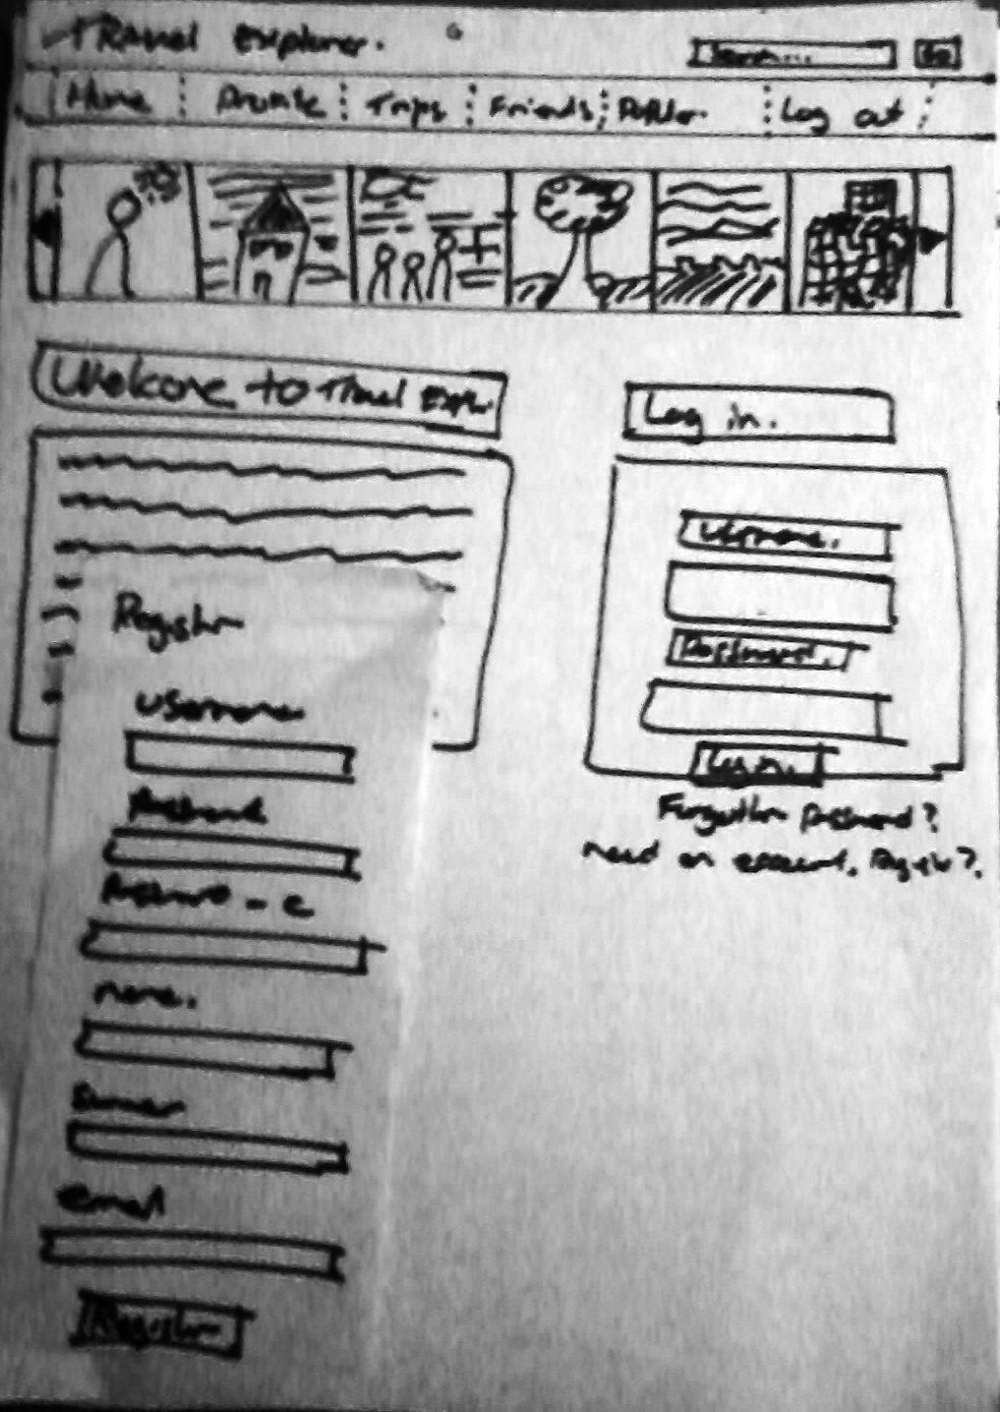
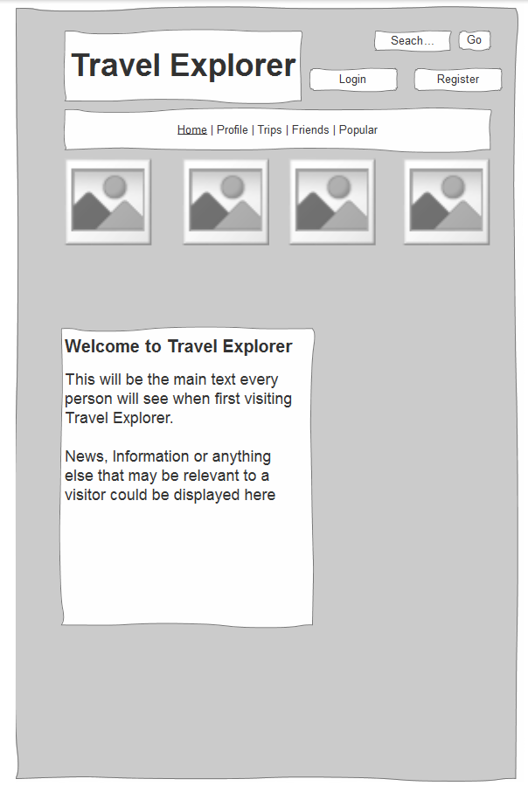
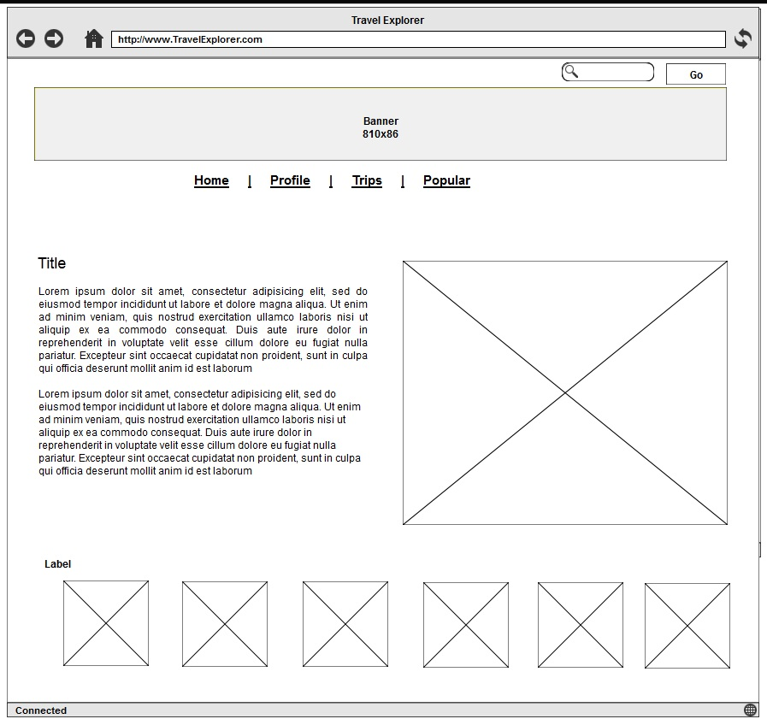
Paper Prototyping
The Evolution of a paper prototype we plan to carry out with the User Centre.
Initial Paper Design
Refined Paper Design
Wireframe

Slide 22
Questions?
For
Travel Explorers Team

